Slide 1
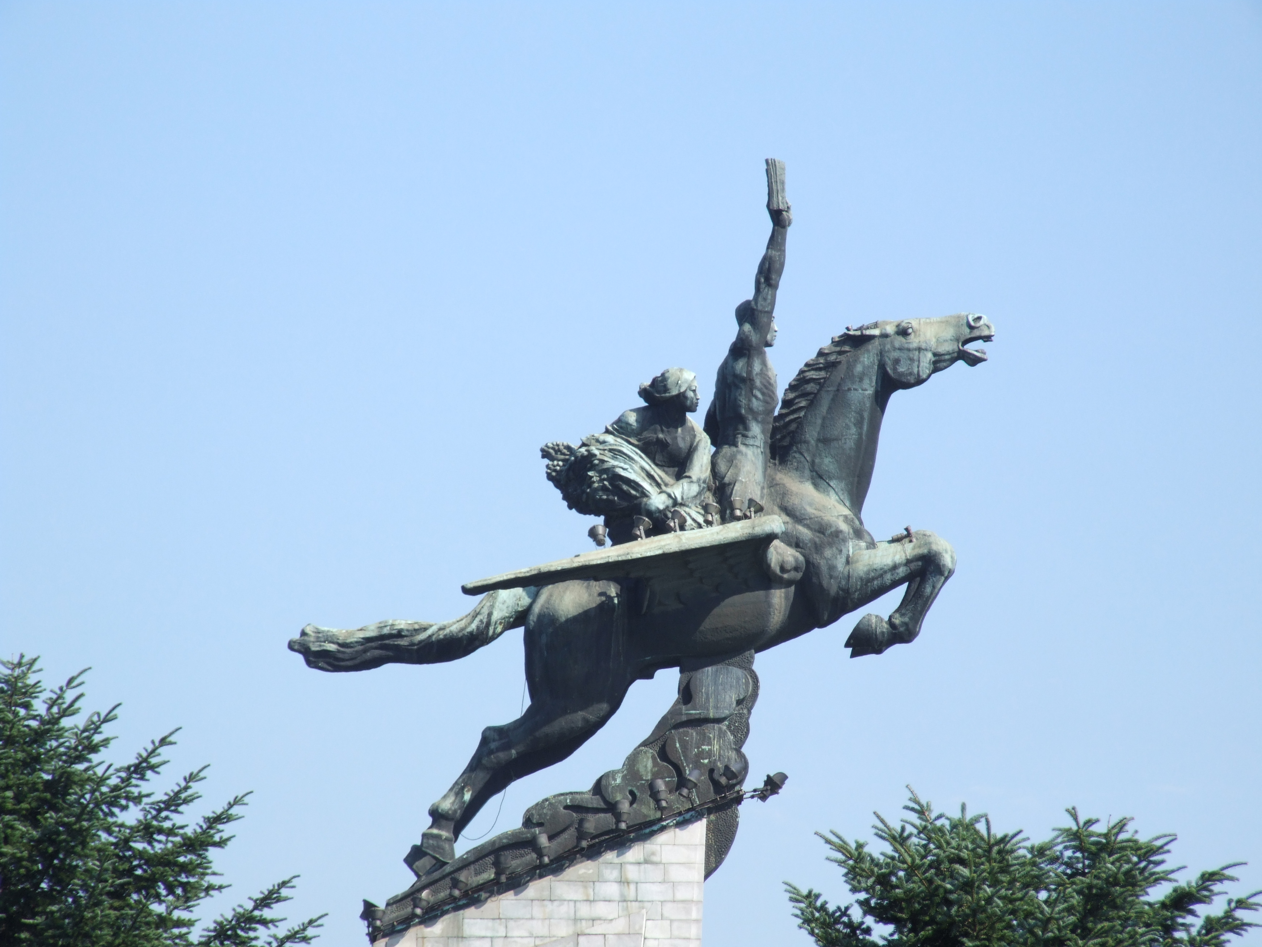
APT38

Slide 2

APT38 is a North Korean state-sponsored threat group that specializes in financial cyber operations. Active since 2014. APT38 targeted banks, financial institutions, casinos, cryptocurrency exchanges, SWIFT system endpoints, and ATMs in at least 38 countries worldwide.

Slide 3
Associated names Nickel Gladstone BeagleBoyz Bluenoroff Stardust Chollima Hidden Cobra !!! Many cybersecurity researchers report all North Korean state-sponsored cyber activity under the name Lazarus Group.

Slide 4

BTW, what is chollima? The chollima or qianlima (lit. 'thousand-li horse') is a mythical winged horse that originates from the Chinese classics and is commonly portrayed in East Asian mythology.

Slide 5
Motives Generally financial, revenue generating. According to the advisory issued by the US Cybersecurity and Infrastructure Security Agency North Korea may then use these funds for its UN-prohibited nuclear weapons and ballistic missile programs.

Slide 6
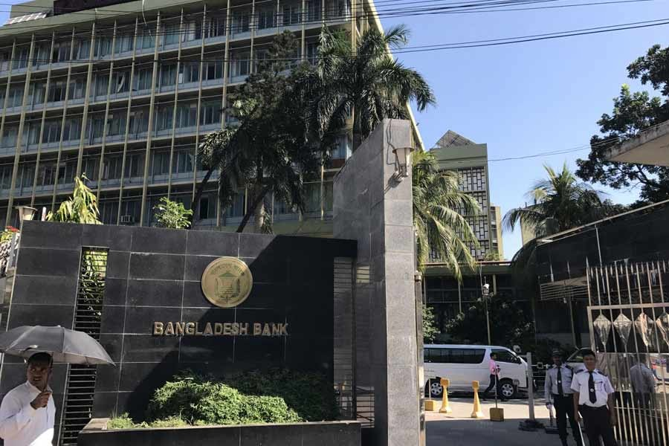
Their most famous attack – Bangladesh Bank Hiest

Slide 7
In February of 2016 $101 million were transferred from the Federal Reserve Bank of New York account belonging to Bangladesh bank, the central bank of Bangladesh, through fraudulent messages in the SWIFT network. $20 million were traced to Sri Lanka (recovered) $81 million were traced to Philippines.

Slide 8
Tactics and Techniques: Watering hole attacks Spear phishing Ransomware Social engineering Brute force attacks

